Slide 1



Chicken Boneless
Teerapath Keawratana
Notes:
Greeting audience

Slide 2
Over view
concept: the chicken has to escape from the enemy and shoot an enemy with the bone to collect more score.
Genre: Arcade, Shooting, endless
Target audience: casual gamers, competitive players
Notes:
Story: ck run away from kitchen, but still in dining room

Slide 3
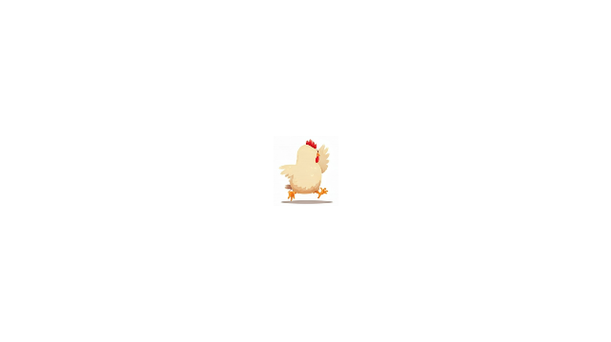


Player control
W
Left Click
A
D
S
Notes:
Chicken movement

Slide 4
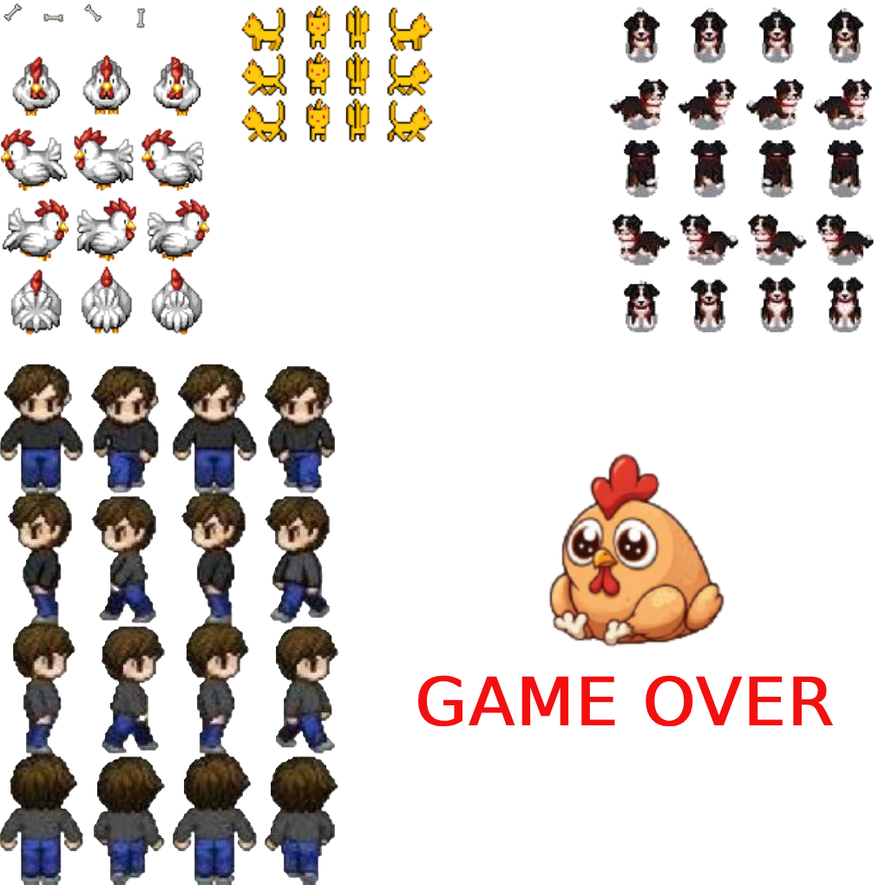
Sprite sheet
www.gameart2d.com

Slide 5
Scene

Slide 6
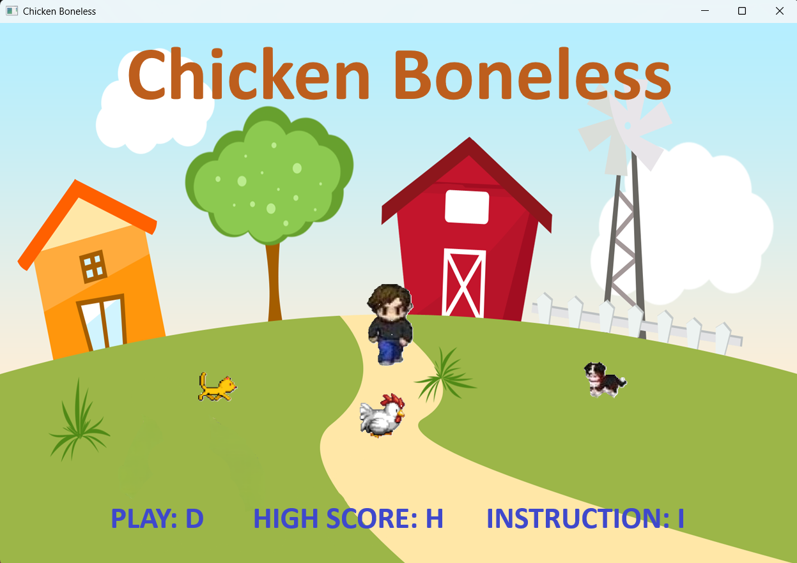
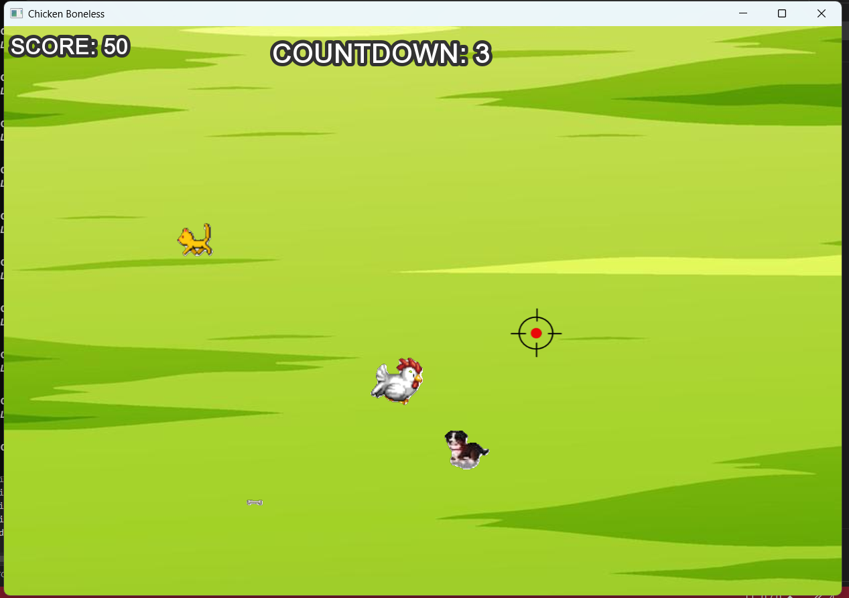
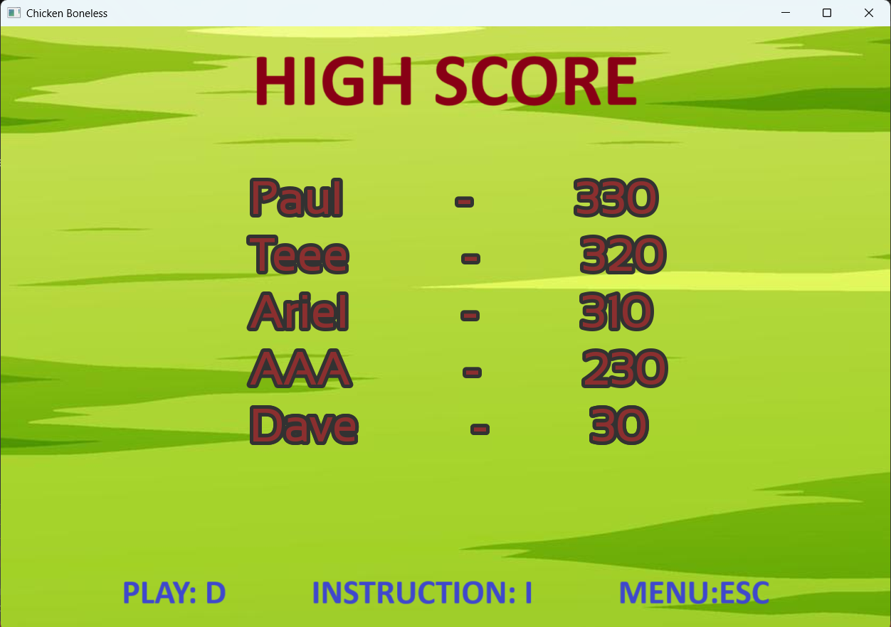
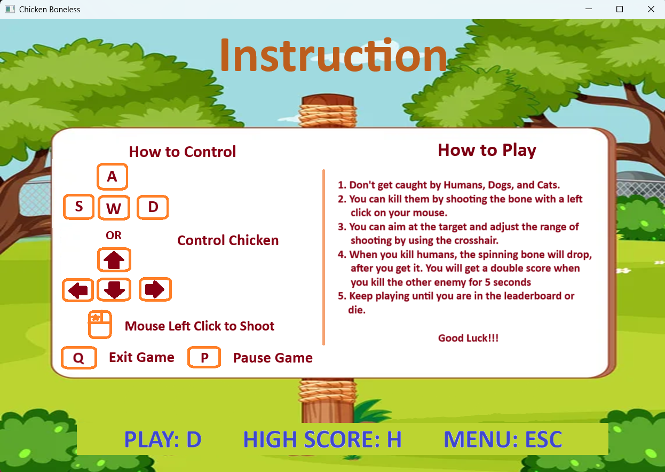

Slide 7
Spawn Enemy

Slide 8
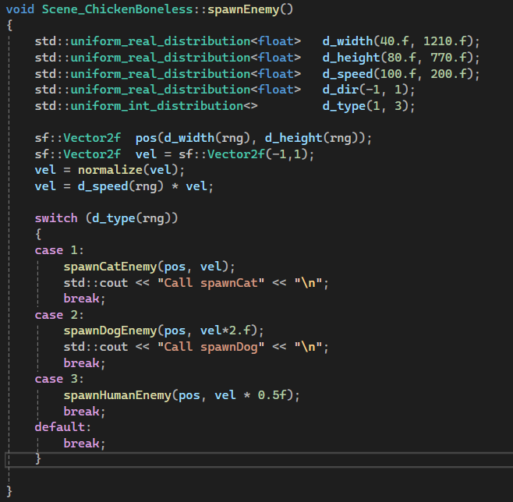

Slide 9
Load high score

Slide 10
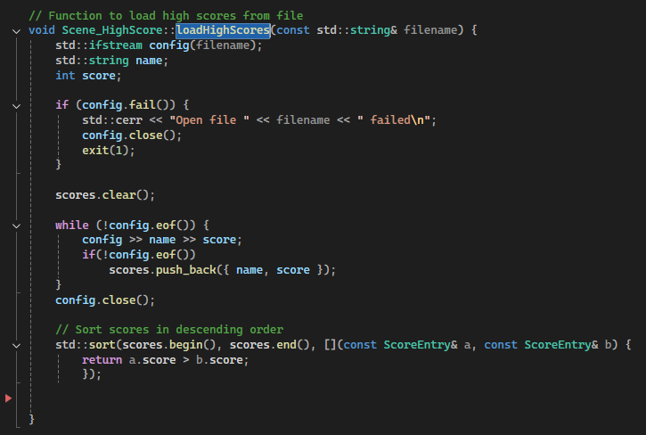

Slide 11
Save high score

Slide 12
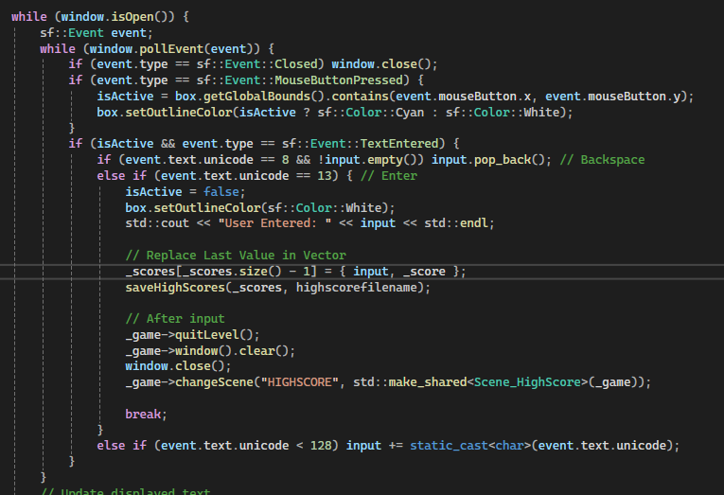

Slide 13
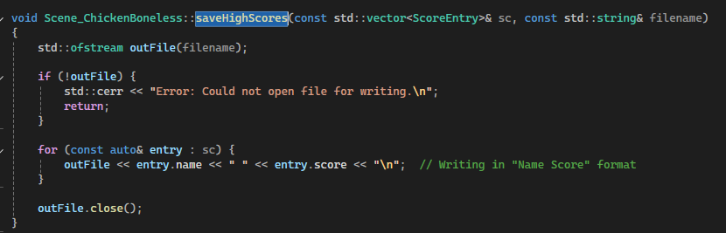

Slide 14
Interesting scene

Slide 16
Thank you

